Slide 1
Session 26: Garbage Collector
Dr. Naveen Kumar
Associate Professor
Amity Institute of Information Technology
Amity University Patna

Slide 2
Garbage Collector
Garbage collector is used for destroying the useless object and it is a part of the JVM.
There are three ways to make eligible objects to garbage collector.
Whenever we are assigning null constants to our objects then objects are eligible for GC (garbage collector).
Java programs perform automatic memory management, objects are created on the heap.
The garbage collector finds these unused objects and deletes them to free up memory.

Slide 3
Example-1 :- Whenever we are assigning null constants to our objects then objects are eligible for GC(garbage collector)
class Test
{ public static void main(String[] args)
{ Test t1=new Test(); Test t2=new Test();
System.out.println(t1);
System.out.println(t2);
t1=null; //t1 object is eligible for Garbage collector
t2=null; //t2 object is eligible for Garbage Collector
System.out.println(t1);
System.out.println(t2);
} };

Slide 4
Example-2 :- Whenever we reassign the reference variable the objects are automatically eligible for garbage collector.
class Test {
public static void main(String[] args) {
Test t1=new Test();
Test t2=new Test();
System.out.println(t1);
System.out.println(t2);
t1=t2; //reassign reference variable then one object is destroyed. System.out.println(t1);
System.out.println(t2);
} };

Slide 5
Example -3:-Whenever we are creating objects inside the methods one method is completed the objects are eligible for garbage collector.
class Test {
void m1() {
Test t1=new Test();
}
public static void main(String[] args) {
Test t=new Test();
t.m1();
System.gc();
}
};

Slide 6
To call the garbage collector explicitly use gc() method it is a static method system class.
Just before destroying object garbage collector will call finalize() method.
class Test extends Object {
public void finalize() {
System.out.println("object destroyed");
}
public static void main(String[] args) {
Test t1 = new Test();
Test t2 = new Test();
System.out.println(t1.toString());
System.out.println(t2.toString()); //using object
t1=null;
t2=null;
System.gc();
} };
Note: //if any exceptions raised in finalize() method those exceptions are ignored & object is destroyed.

Slide 7
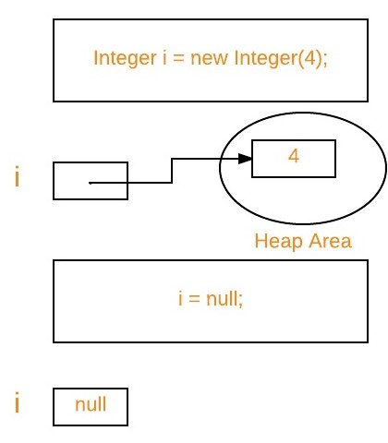

Slide 8
The main objective of Garbage Collector is to free heap memory by destroying unreachable objects.
Automatic garbage collection is the process of looking at heap memory, identifying which objects are in use and which are not, and deleting the unused objects.
An in-use object, or a referenced object, means that some part of your program still maintains a pointer to that object.
An unused or unreferenced object is no longer referenced by any part of your program.
So the memory used by an unreferenced object can be reclaimed.
The programmer does not need to mark objects to be deleted explicitly.
The garbage collection implementation lives in the JVM.

Slide 9
Two types of garbage collection activity usually happen in Java.
Minor or incremental Garbage Collection: It is said to have occurred when unreachable objects in the young generation heap memory are removed.
Major or Full Garbage Collection: It is said to have occurred when the objects that survived the minor garbage collection are copied into the old generation or permanent generation heap memory are removed. When compared to the young generation, garbage collection happens less frequently in the old generation.

Slide 10
Important Concepts Related to Garbage Collection in Java
1. Unreachable objects: An object is said to be unreachable if it doesn’t contain any reference to it.
Integer i = new Integer(4);
// the new Integer object is reachable via the reference in 'i'
i = null;
// the Integer object is no longer reachable.
2. Eligibility for garbage collection: An object is said to be eligible for GC(garbage collection) if it is unreachable. After i = null, integer object 4 in the heap area is suitable for garbage collection in the above image.

Slide 11
Ways to make an object eligible for Garbage Collector
Even though the programmer is not responsible for destroying useless objects but it is highly recommended to make an object unreachable(thus eligible for GC) if it is no longer required.
There are generally four ways to make an object eligible for garbage collection.
1. Nullifying the reference variable
2. Re-assigning the reference variable
3. An object created inside the method
4. Island of Isolation

Slide 12
Ways for requesting JVM to run Garbage Collector
Once we make an object eligible for garbage collection, it may not destroy immediately by the garbage collector.
Whenever JVM runs the Garbage Collector program, then only the object will be destroyed. But when JVM runs Garbage Collector, we can not expect.
We can also request JVM to run Garbage Collector.
There are two ways to do it :
Using System.gc() method: System class contain static method gc() for requesting JVM to run Garbage Collector.
Using Runtime.getRuntime().gc() method: Runtime class allows the application to interface with the JVM in which the application is running. Hence by using its gc() method, we can request JVM to run Garbage Collector.
There is no guarantee that any of the above two methods will run Garbage Collector.
Note: The call System.gc() is effectively equivalent to the call : Runtime.getRuntime().gc()

Slide 13
Finalization
Just before destroying an object, Garbage Collector calls finalize() method on the object to perform cleanup activities. Once finalize() method completes, Garbage Collector destroys that object.
finalize() method is present in Object class with the following prototype.
protected void finalize() throws Throwable
Based on our requirement, we can override finalize() method for performing our cleanup activities like closing connection from the database.
The finalize() method is called by Garbage Collector, not JVM. However, Garbage Collector is one of the modules of JVM.
Object class finalize() method has an empty implementation. Thus, it is recommended to override the finalize() method to dispose of system resources or perform other cleanups.
The finalize() method is never invoked more than once for any object.
If an uncaught exception is thrown by the finalize() method, the exception is ignored, and the finalization of that object terminates.

Slide 14
THANK
YOU

